Slide 1
Machine Learning
Exercise 2 - Regression
Group 21
Anders Begtorp Jensen - 12105480
Bartlomiej Dybcio - 12109606
Robin Wroblowski - 12125432
Notes:
Group number 21
Group members
Anders Begtorp Jensen - 12105480
Bartlomiej Dybcio - 12109606
Robin Wroblowski - 12125432

Slide 2
Outline for the slides
Datasets
Algorithms & Hyperparameters
Gradient Descent
…
Maybe present 1 datasat - then the calculations and so…
Next dataset - calculations
Comparison between datasets?
Comparison between our and TPOT and auto
Conclusions/lessons learned

Slide 3
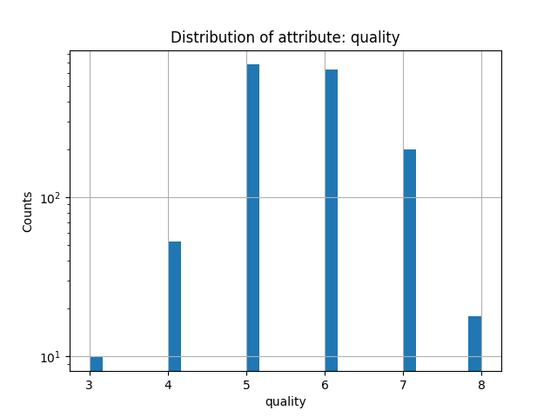
Dataset 1 - Red Wine Quality
Number of instances: 1599
Number of attributes: 12
Target attribute: Quality
Preprocessing:
Min-Max-scaled
One-hot-encoding of city
Removal of outliers (z-score > 3)
Notes:
We believe that despite of quality being categorical here, it might be treated as continuous variable. The fact that it has discrete values is most likely, because people prefer to rate things this way.

Slide 4
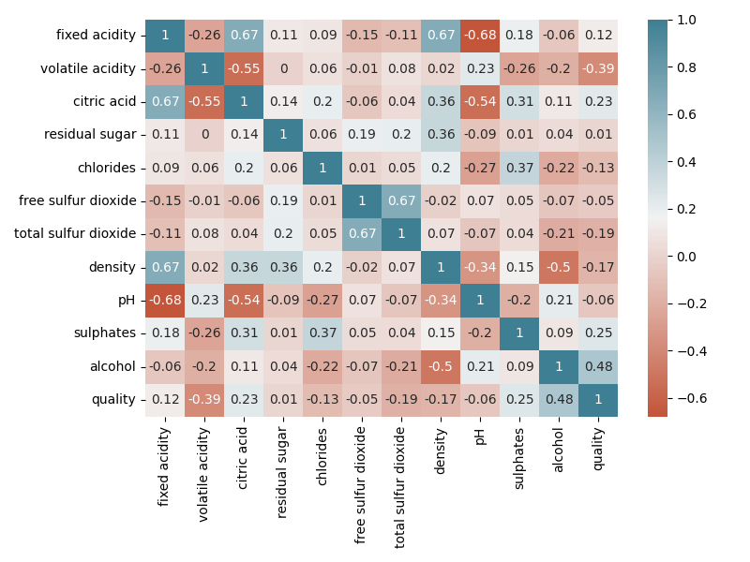
Dataset 1 - Red Wine Quality
Interesting correlations:
Volatile acidity (-0.39)
Citric acid (0.23)
Sulphates (0.25)
Alcohol (0.48)

Slide 5
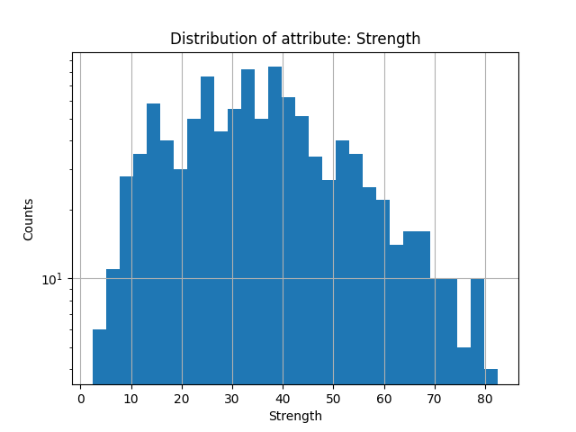
Dataset 2 - Concrete
Number of instances: 1030
Number of attributes: 9
Target attribute: Strength
Preprocessing:
MinMax-scaled
Removal of outliers (z-score > 3)
Notes:
There Various Factors that affects the Strength of Concrete Such as Materials Used, Age etc.
Predict the Strength of the Concrete Based on the Components and Other Factors as Predictors.
Description of Fields are as follows:-
CementComponent:- Amount of cement is mixed
BlastFurnaceSlag:- Amount of Blast Furnace Slag is mixed
FlyAshComponent:- Amount of FlyAsh is mixed
WaterComponent:- Amount of water is mixed
SuperplasticizerComponent:- Amount of Super plasticizer is mixed
CoarseAggregateComponent:- Amount of Coarse Aggregate is mixed
FineAggregateComponent:- Amount of Coarse Aggregate is mixed
AgeInDays:- How many days it was left dry
Strength:- What was the final strength of concrete- (Target)

Slide 6
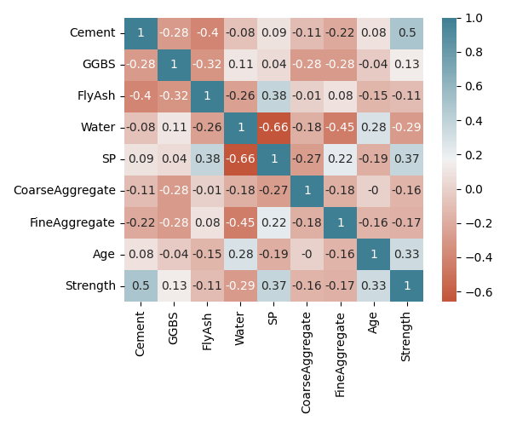
Dataset 2 - Concrete
Interesting correlations:
Age: days left for drying (0.33)
SP: mix of super-plasticizer (0.37)
Water: amount of water (-0.29)
Notes:
There Various Factors that affects the Strength of Concrete Such as Materials Used, Age etc.
Predict the Strength of the Concrete Based on the Components and Other Factors as Predictors.
Description of Fields are as follows:-
CementComponent:- Amount of cement is mixed
BlastFurnaceSlag:- Amount of Blast Furnace Slag is mixed
FlyAshComponent:- Amount of FlyAsh is mixed
WaterComponent:- Amount of water is mixed
SuperplasticizerComponent:- Amount of Super plasticizer is mixed
CoarseAggregateComponent:- Amount of Coarse Aggregate is mixed
FineAggregateComponent:- Amount of Coarse Aggregate is mixed
AgeInDays:- How many days it was left dry
Strength:- What was the final strength of concrete- (Target)

Slide 7
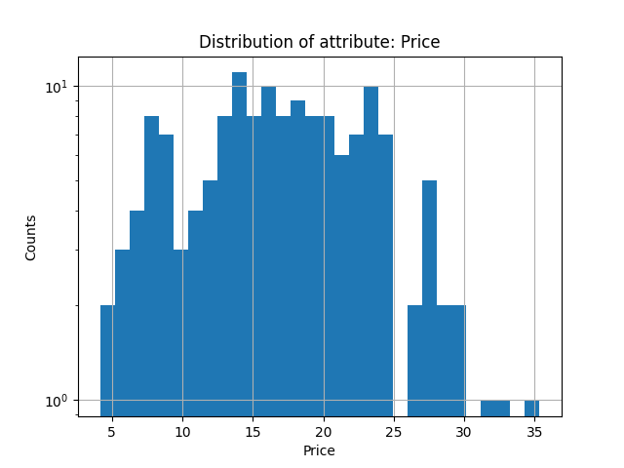
Dataset 3 - Hotel
Number of instances: 150
Number of attributes: 4
Target attribute: Price (for buying the hotel)
Preprocessing:
MinMax-scaled
One-hot-encoding of city
Removal of outliers (z-score > 3)
Notes:
Profit (How much money does this hotel make in a year)
Price in Millions (€)
Square Meter (Hotel Area)
City
Here, "Hotel Prices" does not refer to the cost of spending a night at those hotels but the price for buying them. This would be an interesting chart for someone who wants to buy a hotel and needs to judge whether he/she is overpaying or getting a great deal depending on similar objects in other comparable cities.

Slide 8
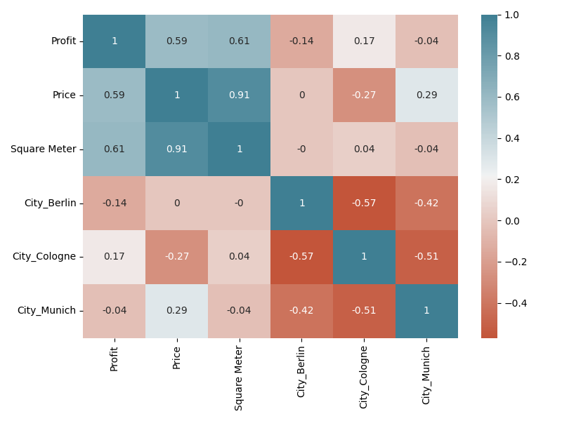
Dataset 3 - Hotel
Notes:
Correlations for Cities should be ignored, as they are one-hot encoded (they will always be negative with 1 hot encoding, and their correlation depends on number of rows with given cities)
High correlations between square meters and price, but not that big correlation price-profit and price-square_meter. (So basically larger hotel will cost more almost for sure, but it will not necessarily make more profit).
Prices seem to be highest in munich, lowest in cologne.

Slide 9
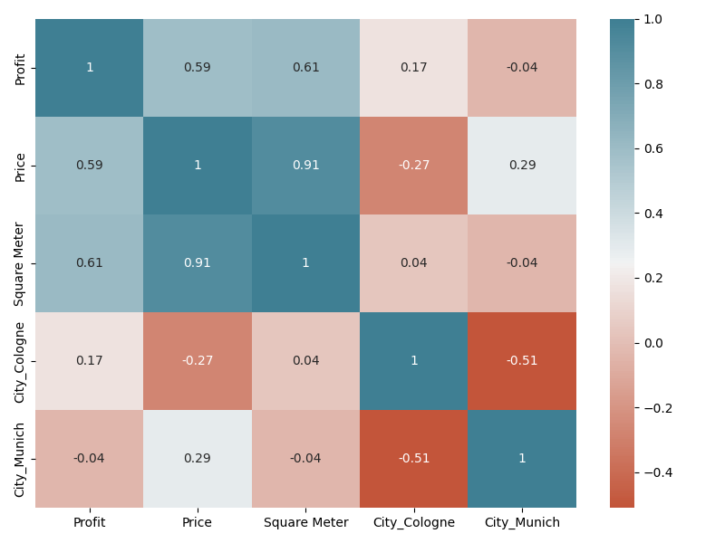
Dummy variable trap
occurs when the data is one hot encoded and all the columns are used
one column is redundant
introduces redundancy and errors

Slide 10
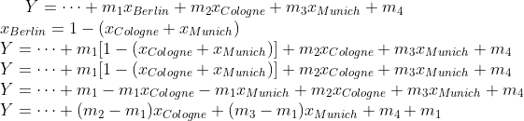
Dummy variable trap - calculations for linear model.
Notes:
This is just small explanation of “what happens with redundant argument and why its bad”.

Slide 11
Approach
Dataset
Selection
Visualisation & Preprocessing
modular Implementation
Regression Algorithm
Selection
modular implementation + testing
Cost function
Optimization function (GD)
Comparison between results and other algorithms

Slide 12
Implementation
Python OOP
Inheritance (main classes Dataset and Algorithm)
→ Much easier to work with (1 line: dataset.calculateXXX())
dataset = Wine(filepath)
aml = AML(dataset)
aml.find_best_regressor()
prediction = aml.best_prediction()
score = aml.best_prediction_score()
print("FINISHED")

Slide 13
Regressors
Linear Methods:
Linear Regression (no parameters)
Elastic Net (alpha, l1_ratio)
Support Vector Machines (n_estimators)
Random Forest Regression (C, eps)
Notes:
Elastic Net Regression combines the best of both worlds from Ridge Regression and Lasso Regression
The parameter alpha multiplies the penalty terms (=0 mean OLS)
The parameter l1_ratio is the mixing parameter between 0 and 1:
=0 means L2 (ridge) and =1 means L1 (Lasso)
Lower C means a higher penalty on regularization
Distance eps around prediction that is not accounted for in the score

Slide 14
Cost Function
Cross-validation
5 splits
Mean result of: MSE
Mean Square Error (MSE) is used as cost function
Average of the squared difference between actual and predicted values
Sensitive to outliers; punishes large error
Goal is to get as low MSE as possible
Notes:
Sensitive to outliers, punishes larger error more

Slide 15
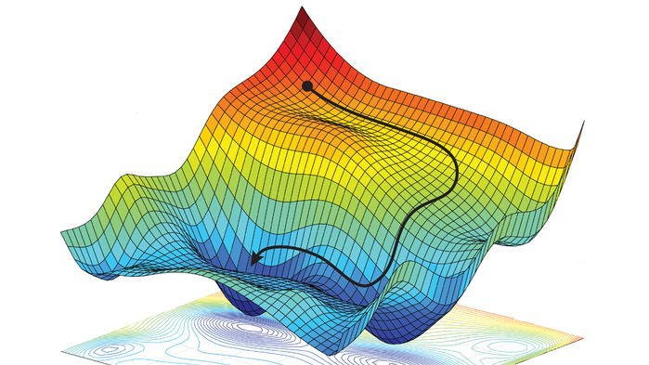
Gradient Descent
While ! (stopping criterium): Approximate Gradient: g <- (fcost(p0+e)-fcost(p0-e))/2 (central difference) Step towards g with distance s*|g| (s = learning rate): x[i] <- x[i-1] - s * grad[i]
stopping criterium: #steps > n (depends on algorithm) OR |g| < threshold

Slide 16
Discussion
Optimization techniques
Evolutionary programming (how to encode the parameters)
Gradient Descent (how to approximate the Gradient)

Slide 17
Discussion
Gradient Descent: problems we’ve encountered
Ranges for hyperparameters
Step size
Stopping criteria
Elastic Net with extreme l1_ratio values
Convergence toward extremal parameters
Oscillations
Small iterations are okay and avoidable
Big iterations are problems (SVM on Concrete and Hotel…)

Slide 18
Discussion
Possible upgrades
Implementation in Matlab
Linear Algebra (computationally interesting)
Easier plotting + live scripts!
Packages for optimization → Use interesting optimization techniques

Slide 19
Discussion
Possible upgrades
Implement Momentum in GD
Without Momentum: x[i] <- x[i-1] - s * d[i] (with d[i] = f’[i])
With Momentum: d[i] <- s * d[i] + m * d[i-1] x[i] <- x[i-1] - s * d[i]

Slide 20
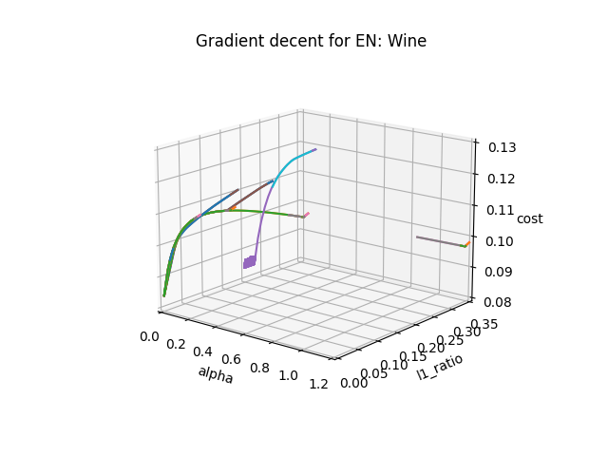
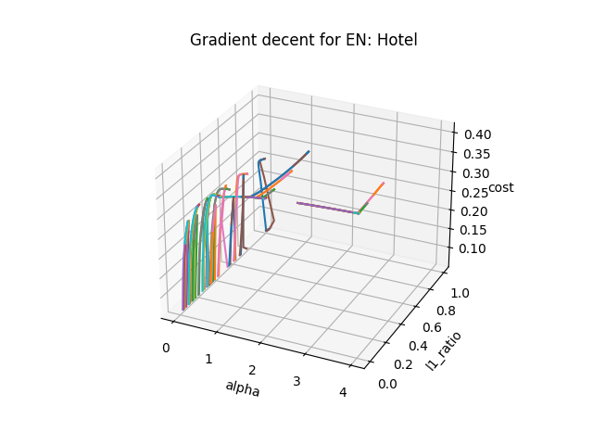
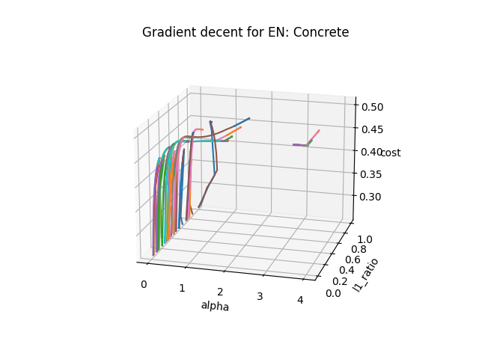
Gradient Descent using Elastic Net

Slide 21
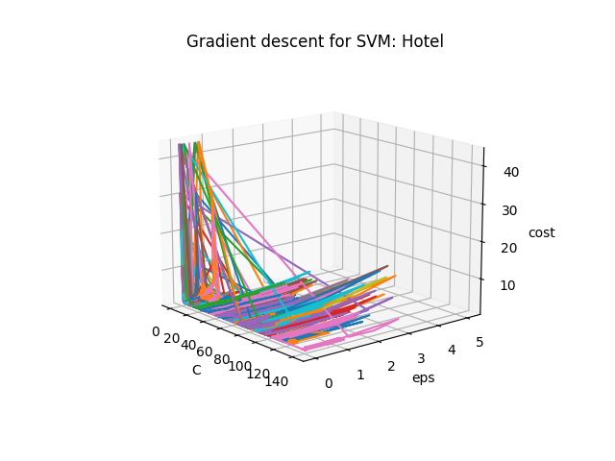
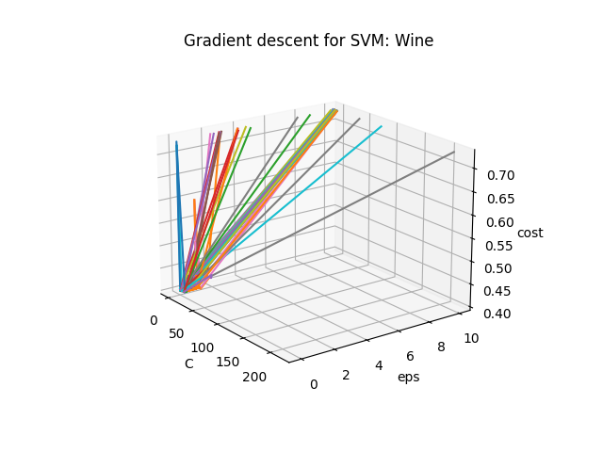
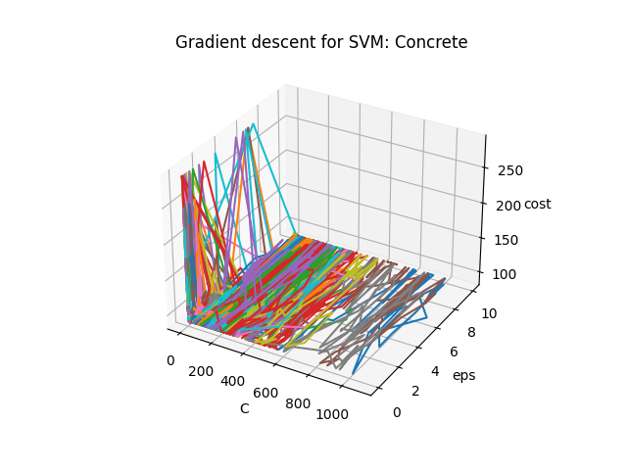
Gradient Descent using SVM

Slide 22
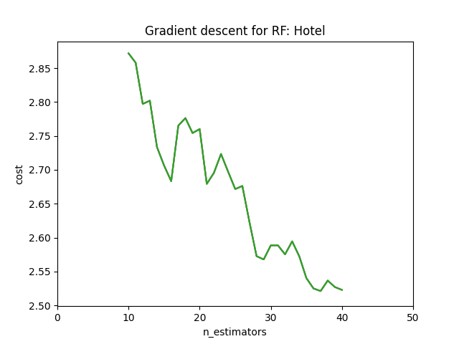
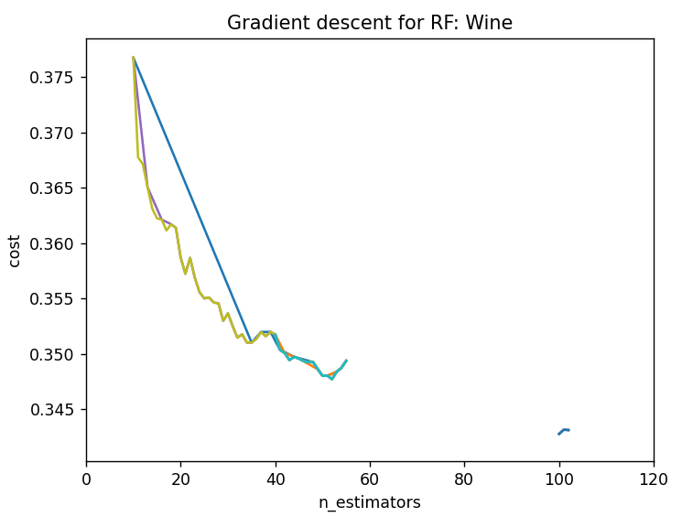
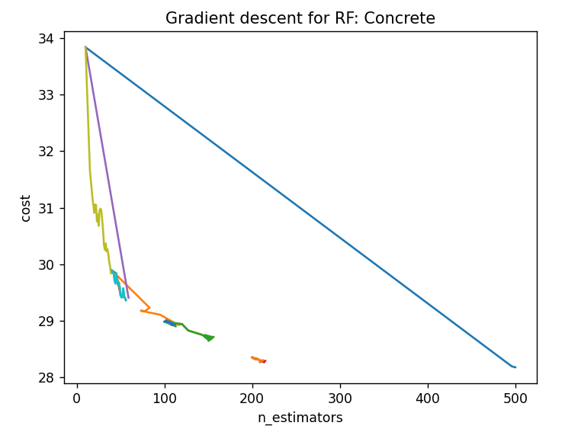
Gradient Descent using Random Forest

Slide 23
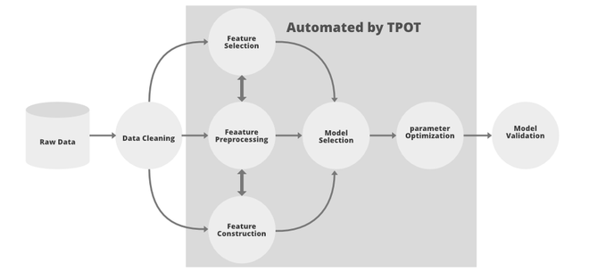
AutoML - TPOT - process diagram

Slide 24
AutoML - TPOT - Wine
Generations | Population | Approx. time | Training score | Test Score
3 | 10 | 30 seconds | -0.60 | -0.581
5 | 50 | 10 minutes | -0.57 | -0.587
100 | 50 | 2 hours | -0.54 | -0.588
Notes:
exported_pipeline = make_pipeline(
PolynomialFeatures(degree=2, include_bias=False, interaction_only=False),
StackingEstimator(estimator=LinearSVR(C=0.01, dual=True, epsilon=0.001, loss="squared_epsilon_insensitive", tol=0.1)),
MinMaxScaler(),
MinMaxScaler(),
OneHotEncoder(minimum_fraction=0.05, sparse=False, threshold=10),
StackingEstimator(estimator=LassoLarsCV(normalize=True)),
StackingEstimator(estimator=LassoLarsCV(normalize=False)),
ExtraTreesRegressor(bootstrap=False, max_features=0.2, min_samples_leaf=1, min_samples_split=3, n_estimators=100)
)

Slide 25
AutoML - TPOT - Concrete
Generations | Population | Approx. time | Training score | Test Score
3 | 10 | 1 minute | -4.74 | -5.13
5 | 50 | 6 minutes | -4.67 | -5.22
100 | 50 | 2 hours | -4.24 | -4.91
Notes:
exported_pipeline = make_pipeline(
ZeroCount(),
StackingEstimator(estimator=SGDRegressor(alpha=0.0, eta0=0.01, fit_intercept=False, l1_ratio=0.5, learning_rate="invscaling", loss="squared_loss", penalty="elasticnet", power_t=10.0)),
XGBRegressor(learning_rate=0.1, max_depth=10, min_child_weight=4, n_estimators=100, n_jobs=1, objective="reg:squarederror", subsample=0.6500000000000001, verbosity=0)
)

Slide 26
AutoML - TPOT - Hotels
Generations | Population | Approx. time | Training score | Test Score
3 | 10 | 10 seconds | -1.11 | -1.14
5 | 50 | 2 minutes | -1.09 | -1.14
100 | 50 | 1 hour | -1.07 | -1.12
Notes:
exported_pipeline = make_pipeline(
make_union(
make_union(
make_union(
FunctionTransformer(copy),
StackingEstimator(estimator=LassoLarsCV(normalize=True))
),
make_union(
make_union(
StackingEstimator(estimator=LassoLarsCV(normalize=True)),
StackingEstimator(estimator=XGBRegressor(learning_rate=0.5, max_depth=5, min_child_weight=15, n_estimators=100, n_jobs=1, objective="reg:squarederror", subsample=0.4, verbosity=0))
),
Binarizer(threshold=0.4)
)
),
StackingEstimator(estimator=XGBRegressor(learning_rate=0.5, max_depth=5, min_child_weight=17, n_estimators=100, n_jobs=1, objective="reg:squarederror", subsample=0.4, verbosity=0))
),
ElasticNetCV(l1_ratio=1.0, tol=0.01)
)

Slide 27
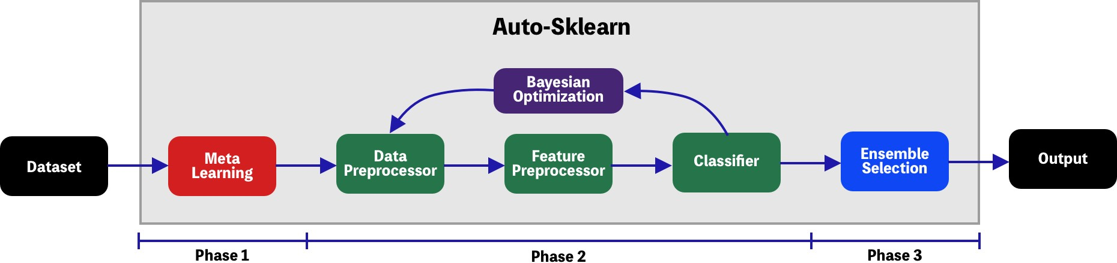
AutoML - Auto-sklearn - process diagram

Slide 28
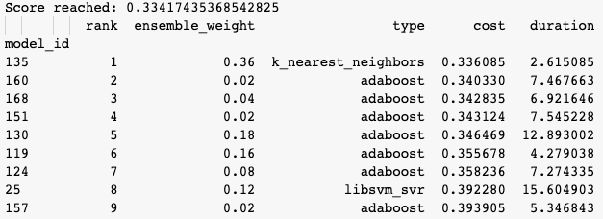
AutoML - Auto sklearn - Results for wine
Notes:
SimpleRegressionPipeline({'data_preprocessor:__choice__': 'feature_type', 'feature_preprocessor:__choice__': 'feature_agglomeration', 'regressor:__choice__': 'k_nearest_neighbors', 'data_preprocessor:feature_type:categorical_transformer:categorical_encoding:__choice__': 'encoding', 'data_preprocessor:feature_type:categorical_transformer:category_coalescence:__choice__': 'no_coalescense', 'data_preprocessor:feature_type:numerical_transformer:imputation:strategy': 'most_frequent', 'data_preprocessor:feature_type:numerical_transformer:rescaling:__choice__': 'normalize', 'feature_preprocessor:feature_agglomeration:affinity': 'euclidean', 'feature_preprocessor:feature_agglomeration:linkage': 'complete', 'feature_preprocessor:feature_agglomeration:n_clusters': 174, 'feature_preprocessor:feature_agglomeration:pooling_func': 'max', 'regressor:k_nearest_neighbors:n_neighbors': 15, 'regressor:k_nearest_neighbors:p': 1, 'regressor:k_nearest_neighbors:weights': 'distance'},
dataset_properties={

Slide 29
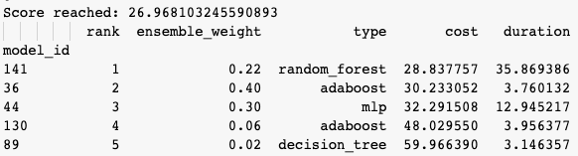
AutoML - Auto sklearn - Results for concrete
Notes:
[(0.400000, SimpleRegressionPipeline({'data_preprocessor:__choice__': 'feature_type', 'feature_preprocessor:__choice__': 'select_rates_regression', 'regressor:__choice__': 'adaboost', 'data_preprocessor:feature_type:categorical_transformer:categorical_encoding:__choice__': 'encoding', 'data_preprocessor:feature_type:categorical_transformer:category_coalescence:__choice__': 'no_coalescense', 'data_preprocessor:feature_type:numerical_transformer:imputation:strategy': 'median', 'data_preprocessor:feature_type:numerical_transformer:rescaling:__choice__': 'power_transformer', 'feature_preprocessor:select_rates_regression:alpha': 0.13545912930339138, 'feature_preprocessor:select_rates_regression:mode': 'fdr', 'feature_preprocessor:select_rates_regression:score_func': 'f_regression', 'regressor:adaboost:learning_rate': 0.10000000000000002, 'regressor:adaboost:loss': 'square', 'regressor:adaboost:max_depth': 9, 'regressor:adaboost:n_estimators': 59},
dataset_properties={

Slide 30

AutoML - Auto sklearn - Results for hotel
Notes:
(1.000000, SimpleRegressionPipeline({'data_preprocessor:__choice__': 'feature_type', 'feature_preprocessor:__choice__': 'fast_ica', 'regressor:__choice__': 'ard_regression', 'data_preprocessor:feature_type:categorical_transformer:categorical_encoding:__choice__': 'no_encoding', 'data_preprocessor:feature_type:categorical_transformer:category_coalescence:__choice__': 'minority_coalescer', 'data_preprocessor:feature_type:numerical_transformer:imputation:strategy': 'mean', 'data_preprocessor:feature_type:numerical_transformer:rescaling:__choice__': 'robust_scaler', 'feature_preprocessor:fast_ica:algorithm': 'parallel', 'feature_preprocessor:fast_ica:fun': 'logcosh', 'feature_preprocessor:fast_ica:whiten': 'False', 'regressor:ard_regression:alpha_1': 7.184864555193486e-05, 'regressor:ard_regression:alpha_2': 6.275195010620023e-08, 'regressor:ard_regression:fit_intercept': 'True', 'regressor:ard_regression:lambda_1': 3.9768277580589166e-07, 'regressor:ard_regression:lambda_2': 6.456700536135052e-05, 'regressor:ard_regression:n_iter': 300, 'regressor:ard_regression:threshold_lambda': 15298.493747162094, 'regressor:ard_regression:tol': 0.0006858006517801051, 'data_preprocessor:feature_type:categorical_transformer:category_coalescence:minority_coalescer:minimum_fraction': 0.010000000000000004, 'data_preprocessor:feature_type:numerical_transformer:rescaling:robust_scaler:q_max': 0.7141830494094688, 'data_preprocessor:feature_type:numerical_transformer:rescaling:robust_scaler:q_min': 0.19048075967359765},
dataset_properties={

Slide 31
Result comparison - Wine
AutoML | Time | Best Score
“Ours” (RF) | 35 min. | 0.33
TPOT | 2 hours | 0.59
auto-sklearn | 1 hour | 0.58
Notes:
We don’t consider shortest tpot output as “the best” relevant result, because:
tpot is based on some randomness,
it got algorithm with bad training score, and somehow it got better performance on test one
it might not be reproducible, maybe “long” training got some unlucky split, or *insert any random negative circumstance*
Auto-sklearn doesnt allow RMSE so I took sqrt(MSE), it’s not visible in code, cause I did it manually.

Slide 32
Result comparison - Concrete
AutoML | Time | Best Score
“Ours” (EN) | 45 min. | 85.61
TPOT | 2 hours | 4.91
auto-sklearn | 1 hour | 5.19
Notes:
RF Housing: ((37,), 2.521150671414661)
SVM Housing: ((25.943932626978413, 0.784575590117621), 1.265604104212246) EN Housing: ((1e-08, 1), 1.3286208340720473)
RF Concrete: Mssing
SVM Concrete: ((25.943932626978413, 0.784575590117621), 1.265604104212246) - TBD
EN Concrete: ((0.02270481300092797, 1), 85.61987280823215)
RF Wine: ((840,), 0.3387444071423663)
SVM Wine: ((6.231473732031142, 0.872515650751803), 0.39794957470186637)
EN Wine: ((1e-08, 1e-06), 0.39870648471236)

Slide 33
Result comparison - Hotels
AutoML | Time | Best Score
“Ours” (SVM) | 20 min. | 1.26
TPOT | 1 hour | 1.12
auto-sklearn | 1 hour | 1.09

Slide 34
Conclusions
Existing AutoML-algorithms:
are relatively easy and quick to implement,
do a good job
execution takes a lot of time
more difficult to understand the output (compared to “manual” work)
no need to specify (and implement) different algorithms and hyperparameters to look for
but it is possible to choose the algorithms you want

Slide 35
Conclusions
Execution of “our” took more time in total
We achieved lower error for autoML systems
Choice of algorithms was terrible for Concrete dataset, the error is outrageously big.
It took significantly more time to implement “our” autoML.
Overall:
It is easier, faster and better performing to use autoML systems, but it is much harder to understand the reasoning. The only drawback is that they took longer to execute.

